Slide 1


Tóth Erik István – Database, Project manager
Bércesi Krisztián – Backend
Tóth Botond Béla - Frontend
KEB WEBSHOP
http://www.kebshop.hu

Slide 2
INTRODUCTION
FRONTEND
COMMUNICATION
JIRA WORKSPACE
DATABASE
CONTENTS
BACKEND
PAGE DEMO
QUESTIONS

Slide 3
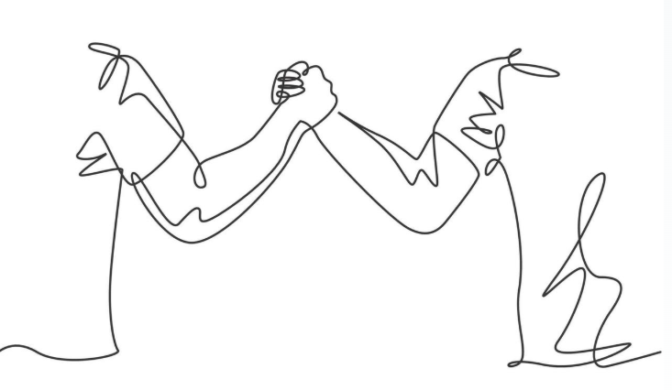
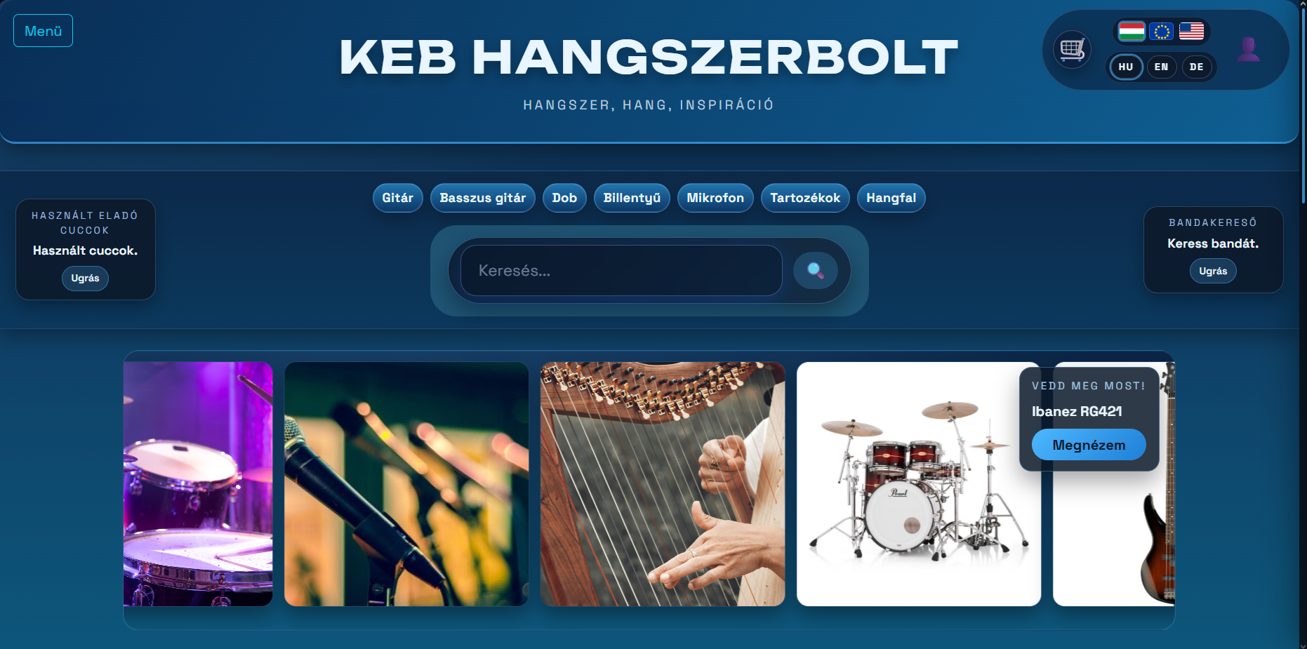
INTRODUCTION
„FROM MUSICIANS, TO MUSICIANS”
Our platform aims to support musicians.
An international social place fror musicians.
We aimed to create something entirely new.

Slide 4
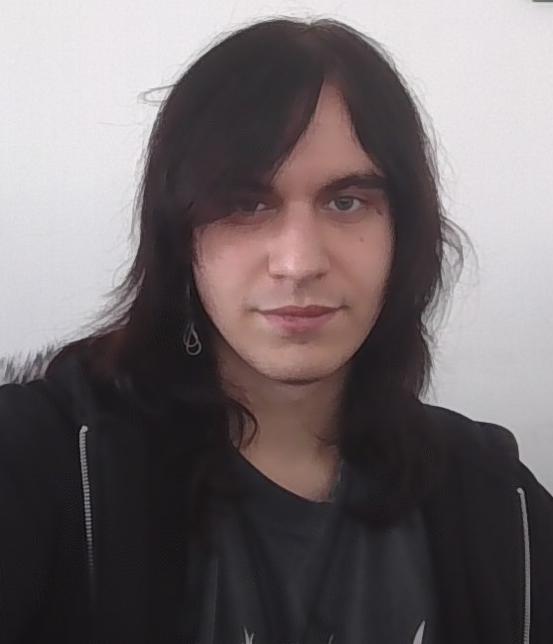
FRONTEND – Tóth Botond
01
02
03
04
05
How i formed the page
Why did i choose this theme/How did i align it with Music?
My frontend Development.
JIRA workspace
Figma desing

Slide 5


FRONTEND – Tóth Botond
Why did i choose this theme?
Our team is full with musicians/music lovers
We know what’s lacking in online music stores.
We think that a best developer is a user.
We found the concept exciting and wanted to create our own, adding our personal ideas and improvements.

Slide 6
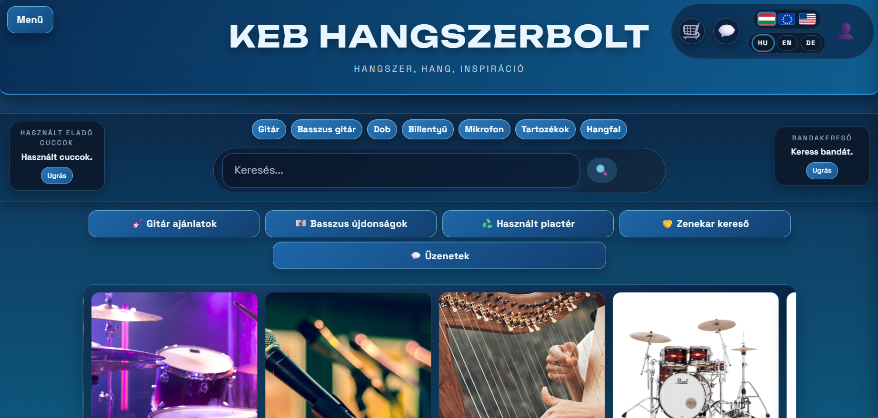
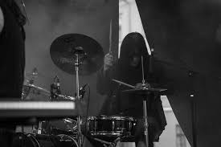

FRONTEND – Tóth Botond
Reason for our colors
Our Music teacher, always used the color blue for his projects, and we grew fond of it.
Our Favourite type of music is made with electrical instruments. And blue reminds us of electricity
This two fact made us choose the color blue.
there are ligther themes in the settings of our page for people who have hard time operating colored pages

Slide 7
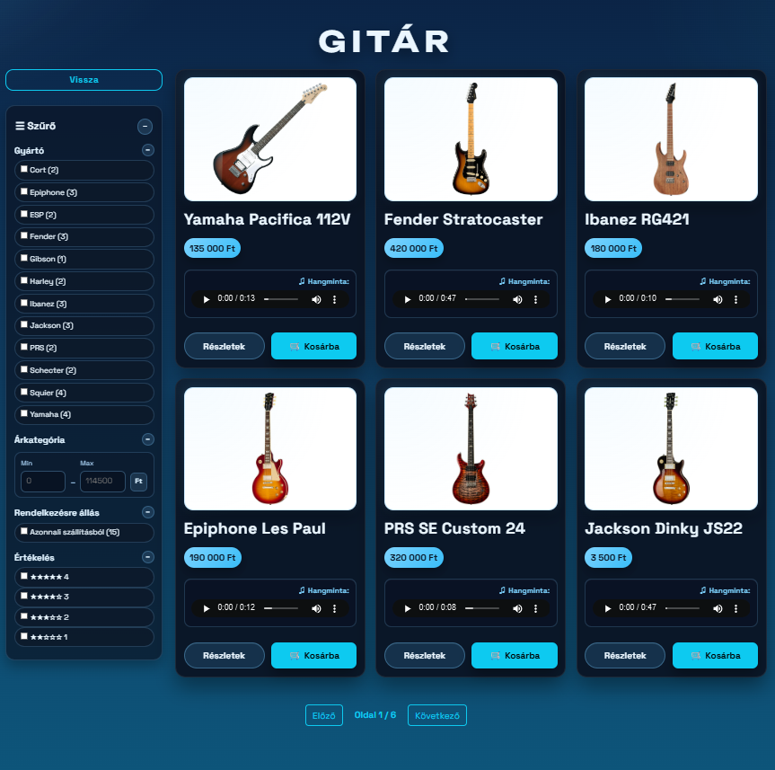
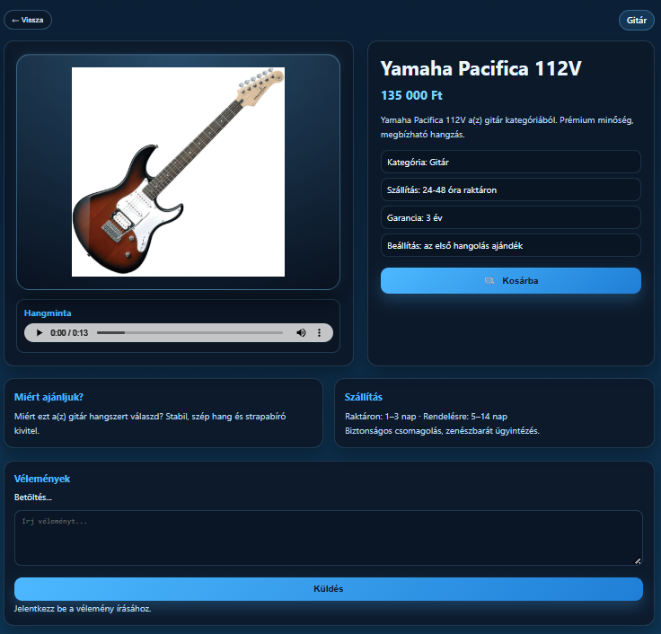
FRONTEND – Tóth Botond
The Product Page
The goal was to create a visually clean and easy-to-navigate interface.
users can select what they want to see according to:
reviews, instrument types, price, or just by listening to their sounds

Slide 8
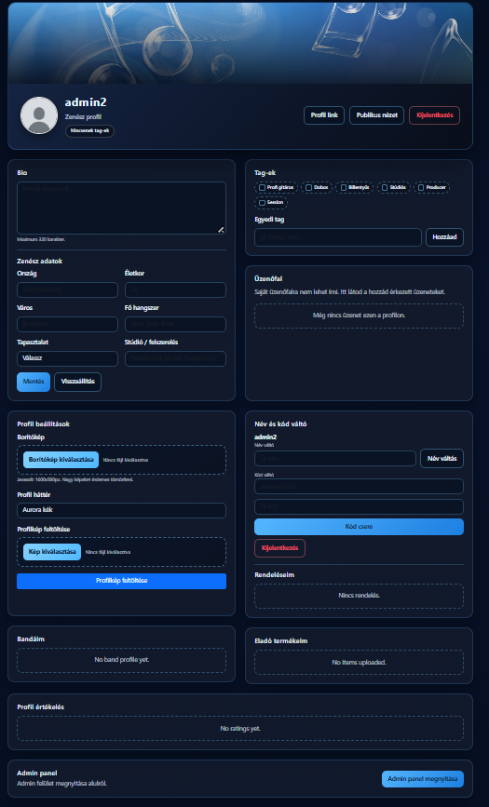
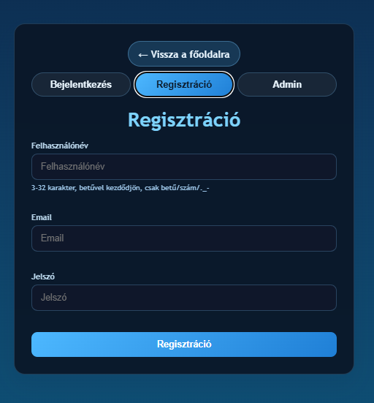
FRONTEND – Tóth Botond
Registration /Profile Page
Designed and developed the user registration interface
Implemented form validation (required fields, email format, password rules)
Connected the form to the backend via REST API
User data is securely stored in the SQL database

Slide 9
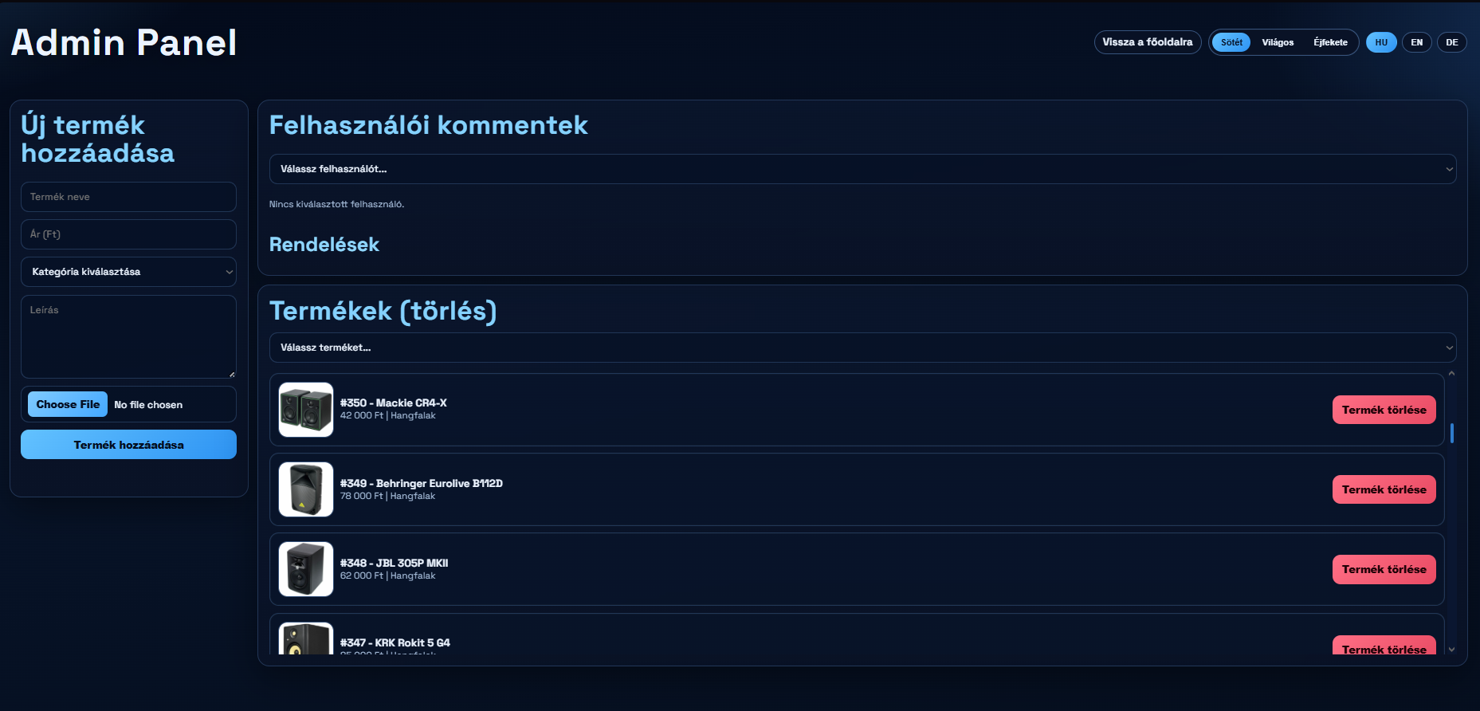
FRONTEND – Tóth Botond
Admin Page
Developed the admin dashboard interface
Managed user comments and reviews
Ordered monitoring and management system
Desing is Easy to navigate and moderate the website

Slide 10
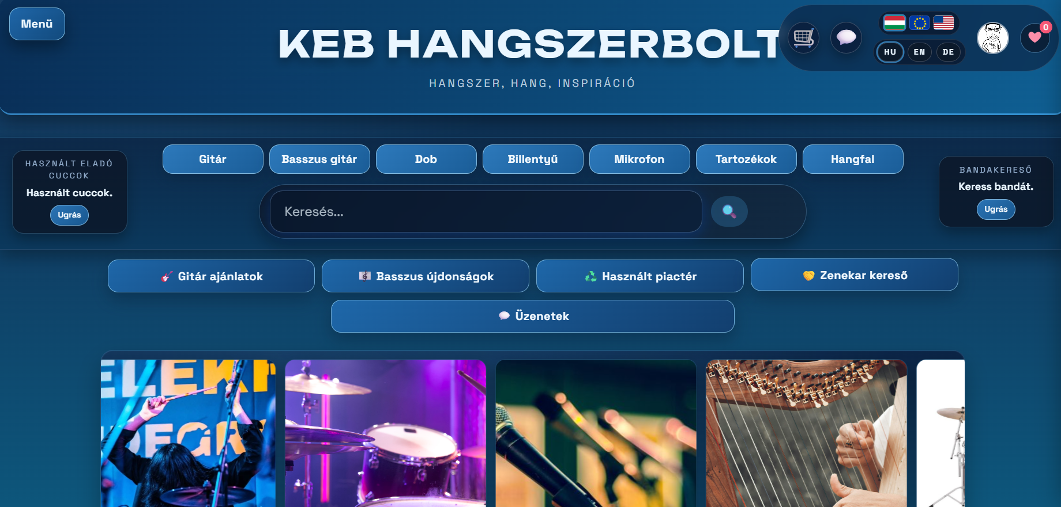
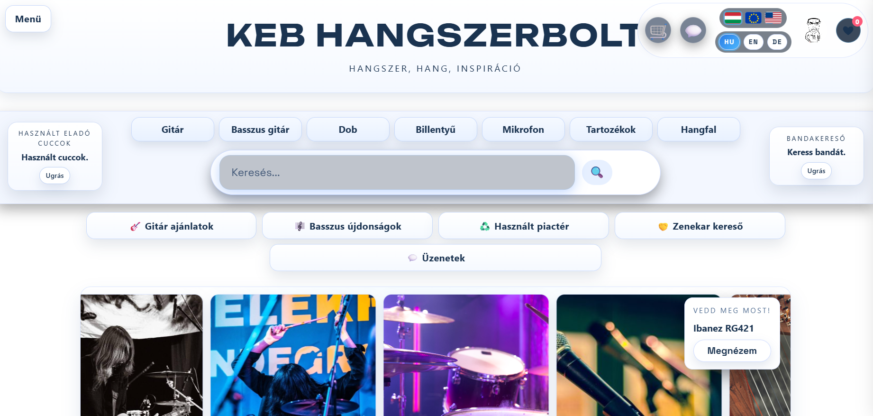
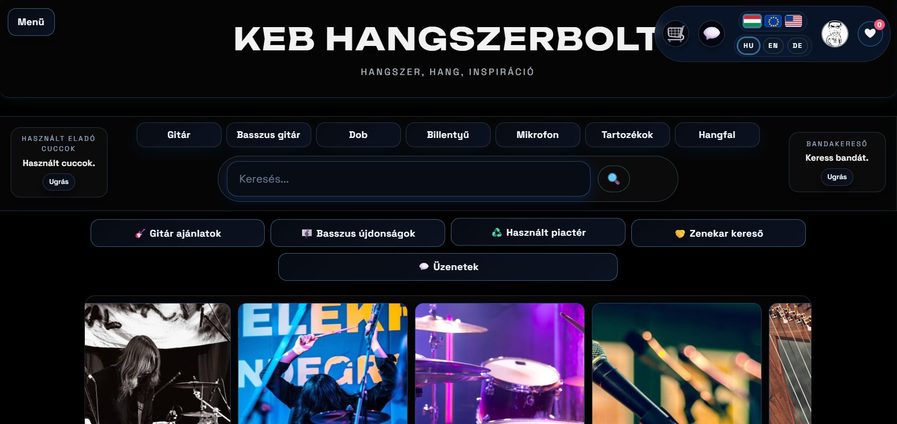
FRONTEND – Tóth Botond
Main Page
I implemented 3 color palettes for our website to accomadate everyones needs
This color palette work on all pages
The top menu makes navigation easy since every part of the website is reachable from there

Slide 11
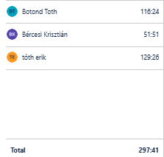
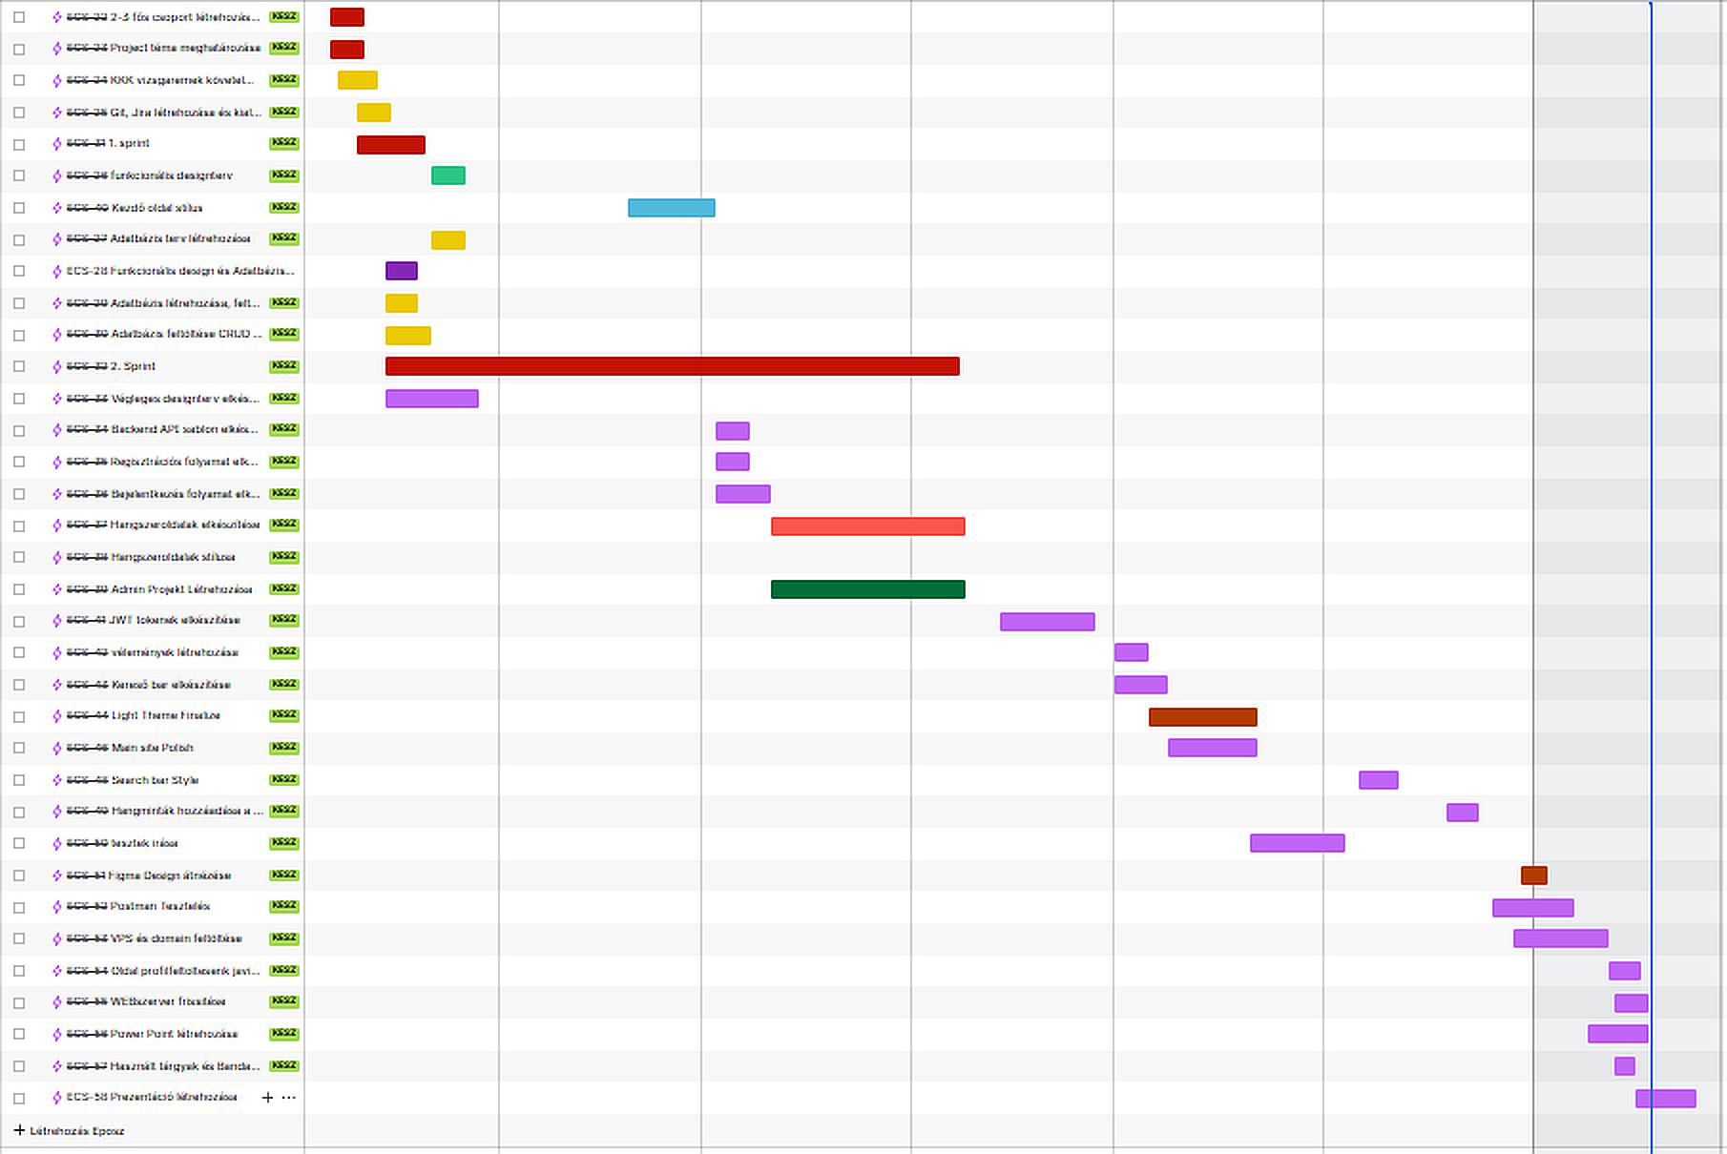
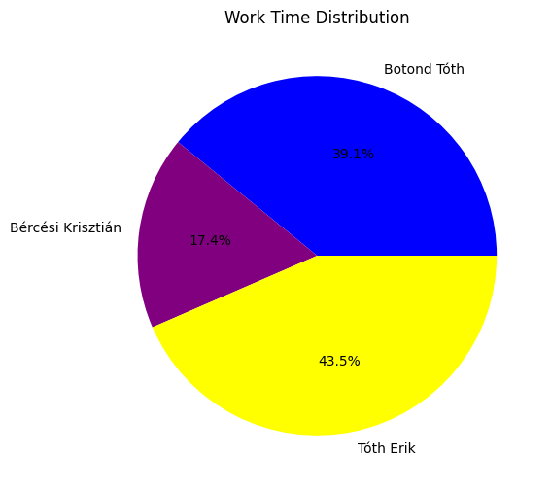
JIRA workspace
JIRA
We used JIRA to log our hours of working on the project
We used different colors for every type of mission we had for ourselves
We worked a total of 297 hours on the project
Tóth Botond 116 hours
Bércesi Krisztián 51hours
Tóth Erik 129 hours

Slide 12
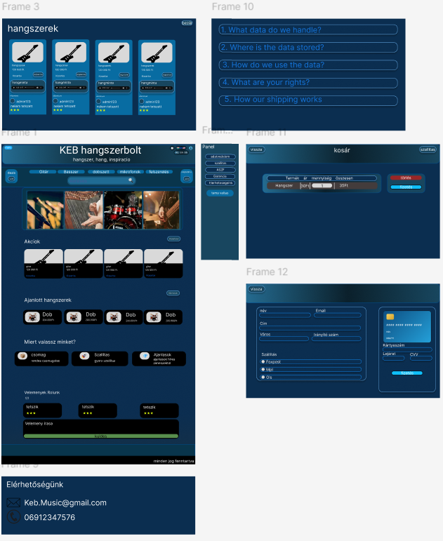
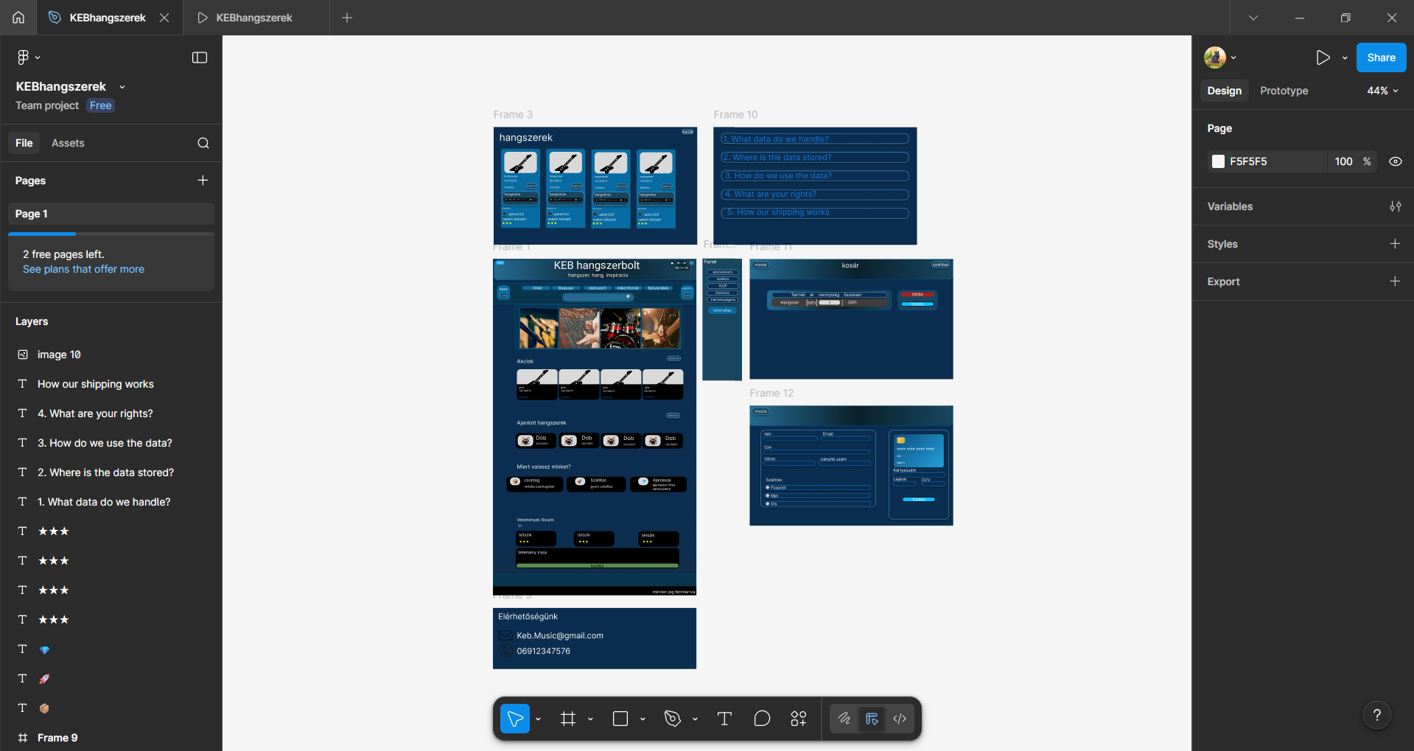
My Figma desing
Figma Desing
This was my first visualization of the pages desing, though this changed through development.

Slide 13

BACKEND – Bércesi Krisztián
01
02
03
04
My languages
The process of me creating the website
How i connected the backend to database
Our Communication

Slide 14
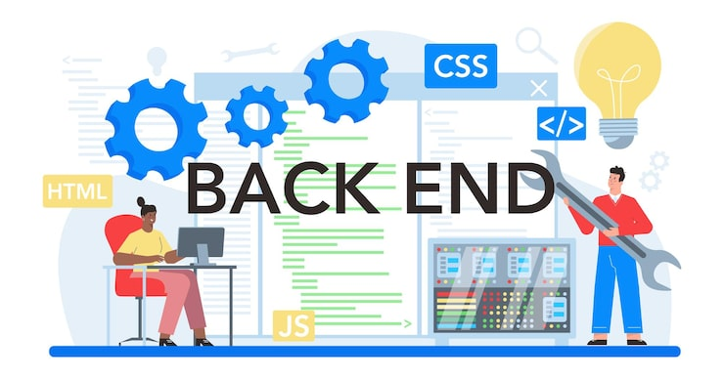
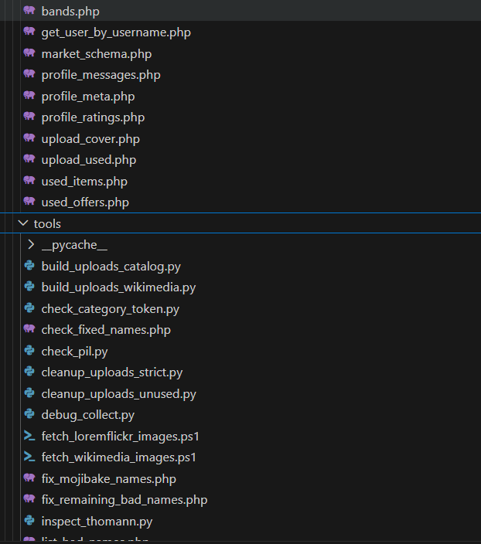
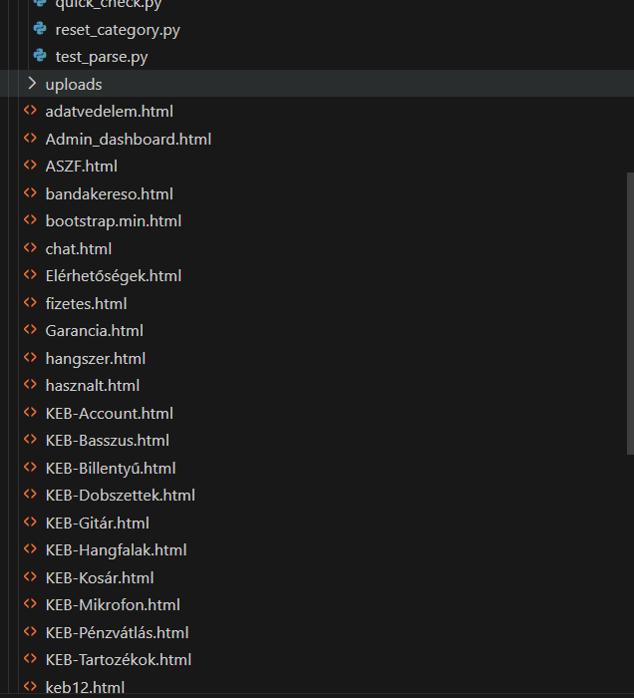
BACKEND – Bércesi Kriszitán
Our backend
It manages user authentication (registration/login), validates input data, and controls access to features.
Data is stored and retrieved through the database, ensuring fast and secure communication between the app and users.
The backend also provides API endpoints so the frontend can send and receive information smoothly.

Slide 15
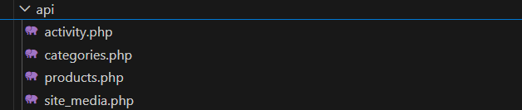

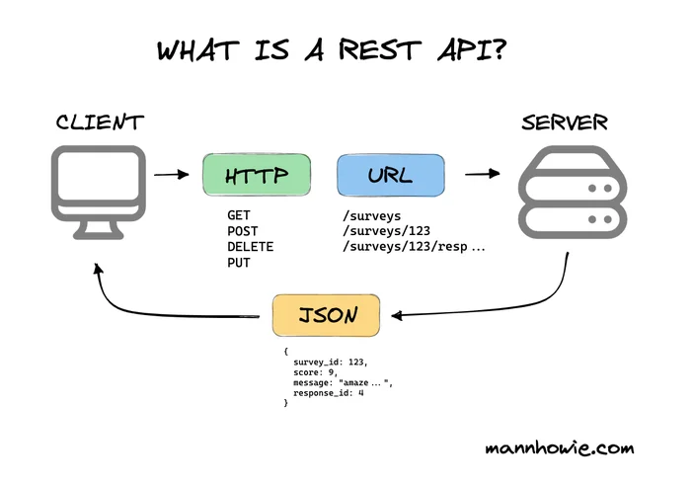
BACKEND – Bércesi Kriszitán
API’s
We used a REST API for communication.
It allowed independent operation of the two systems.
Data is transferred in JSON format.
It simplified database integration and real-time data display.
The REST architecture improved scalability and maintainability.

Slide 16


BACKEND – Bércesi Kriszitán
My languages
I mainly used PHP for the backend because it was convenient to work with, easy to test, and straightforward to connect to the database.
I also combined PHP with some JavaScript to create dynamic product pages.
This combination allowed me to create a responsive and efficient webshop environment
I also used HTML to give the page a base structure

Slide 17
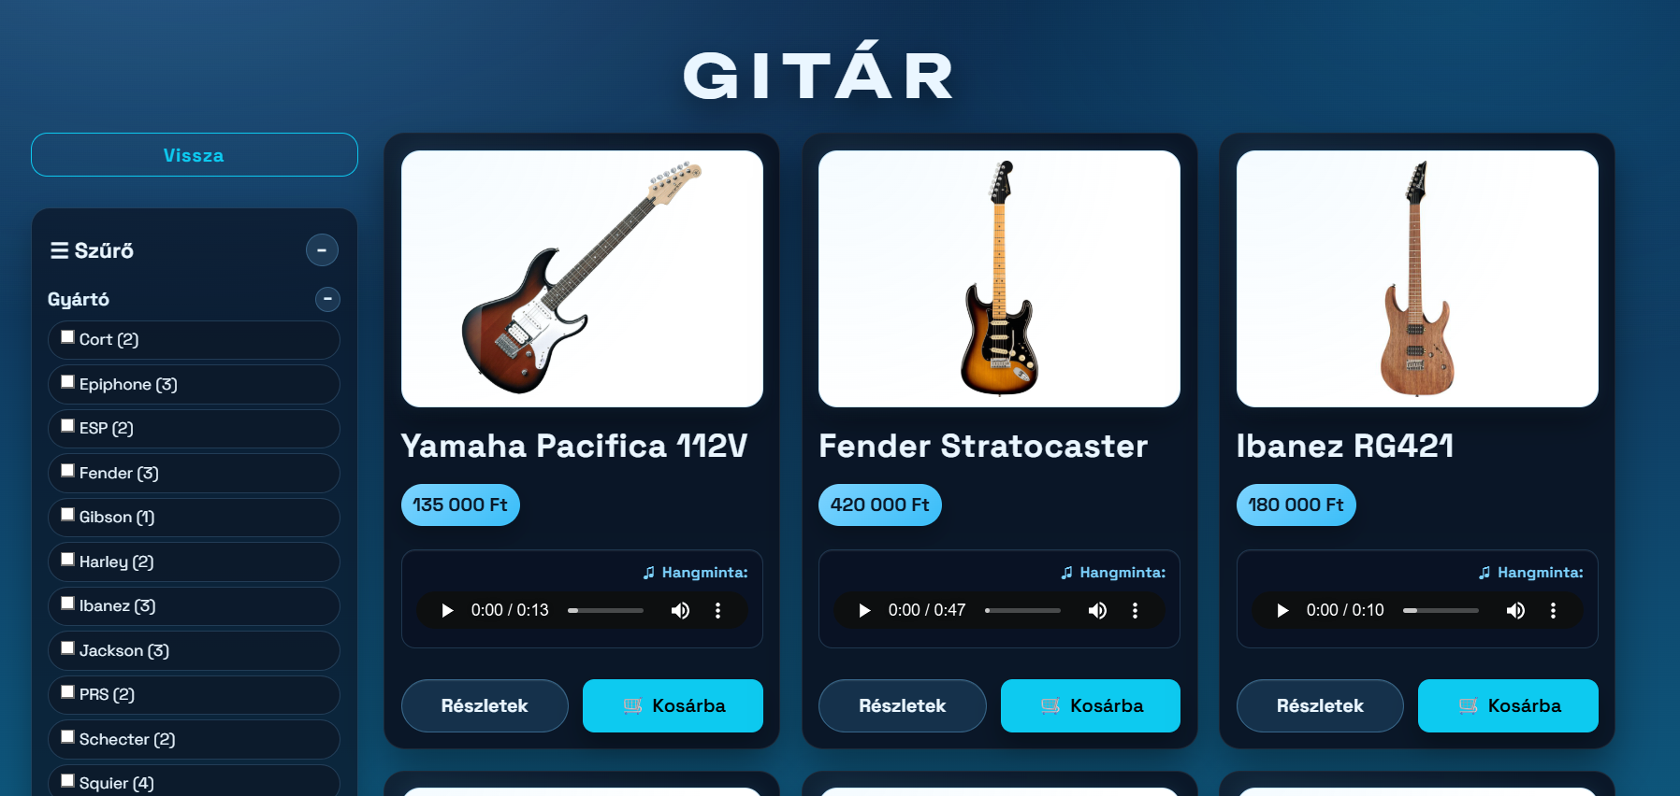
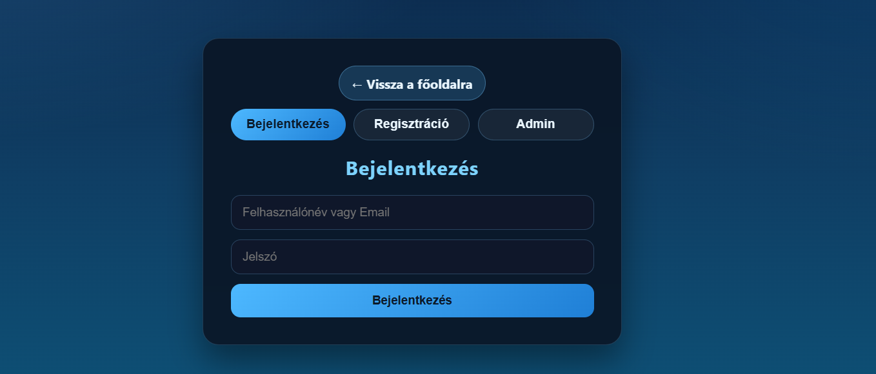
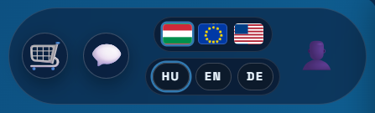
BACKEND – Bércesi Kriszitán
My process
First Erik my teammate creates the database for the page.
After this i created Pages for the products and started creating the login/Registration/Admin page.
I also started the comment fuction and message function to create a social platform feeling to the page like we introduced it.
I made a language and a currency changer to make u page more international.
Also implemented some API’s for the page’s Cart (like the foxpost mail boxes)

Slide 18
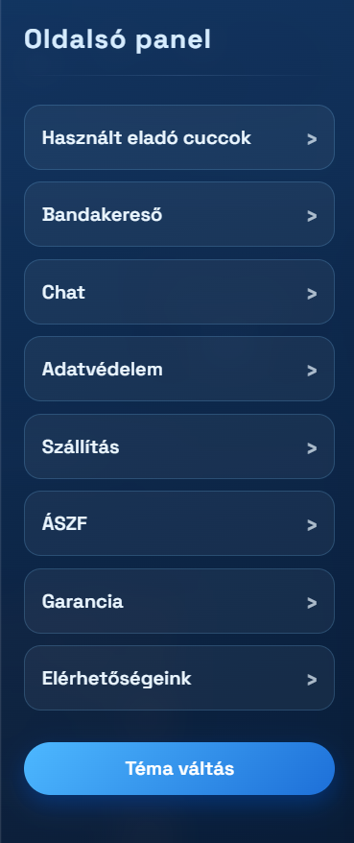
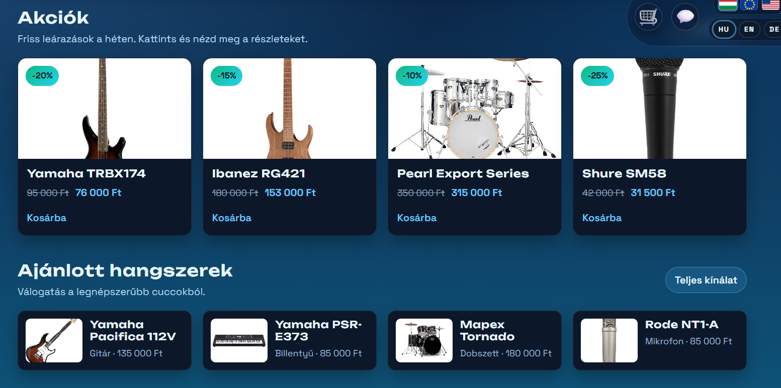
BACKEND – Bércesi Kriszitán
Database connection
Loaded instruments dynamically from database
Managed images, prices, and product categories
Implemented Connected webshop interface to product database
admin data handling
Enabled multilingual data support

Slide 19
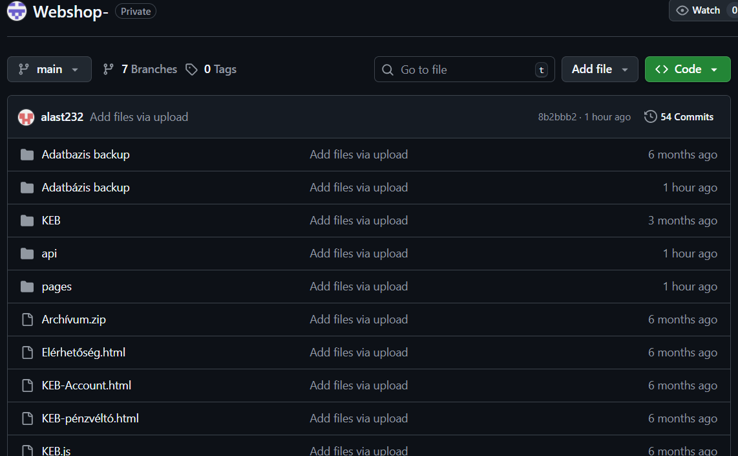
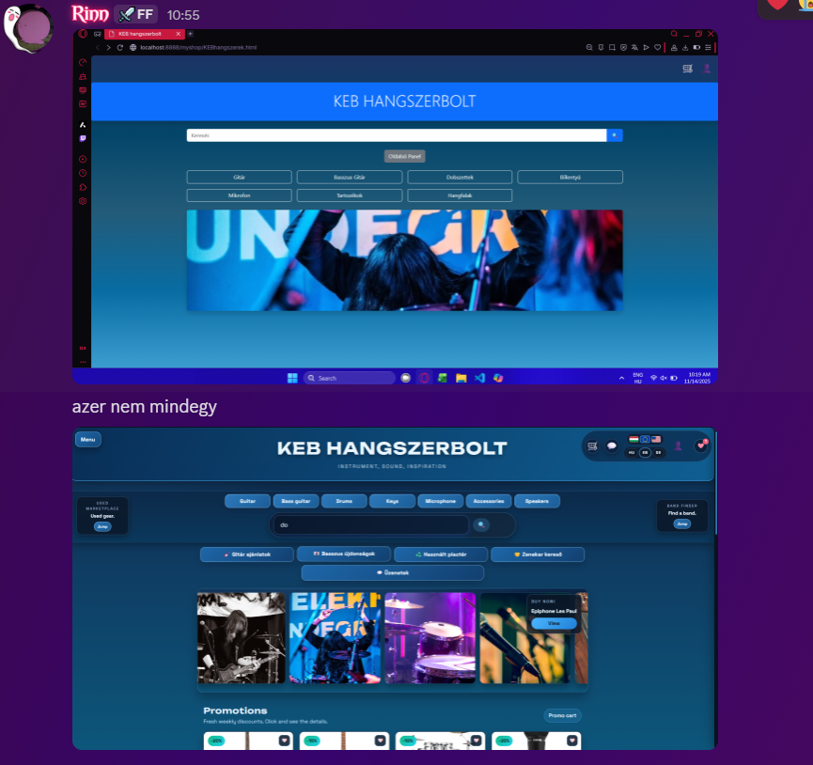
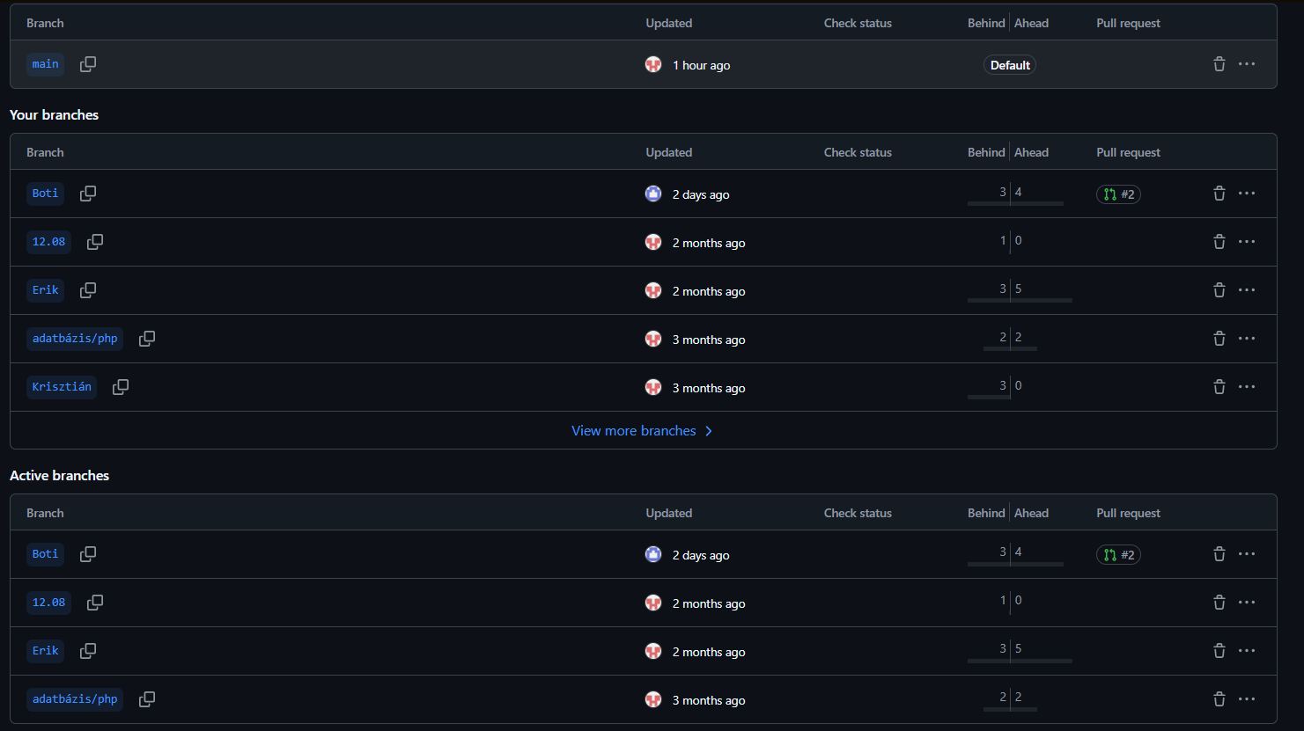
Our communication
Communication
We used Github to share our files with each other and made different branches for all of us
This made file sharing convenient
We also used discord for communication which really helped during home office days

Slide 20
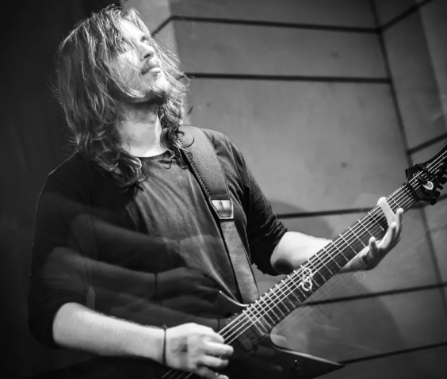
DATABASE – Tóth Erik
01
02
03
04
My Database setup
Database contents
My work with webservers and domains
My work as the project manager

Slide 21

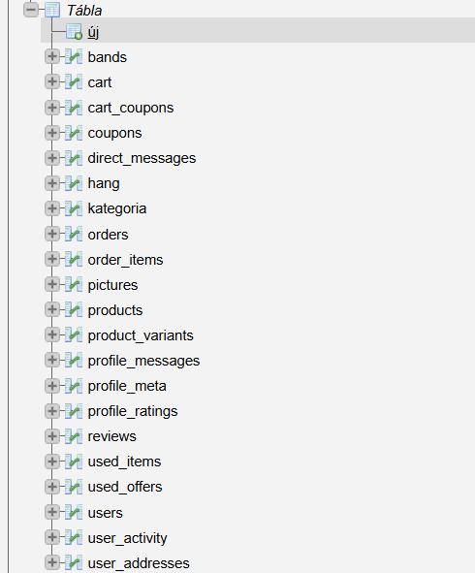
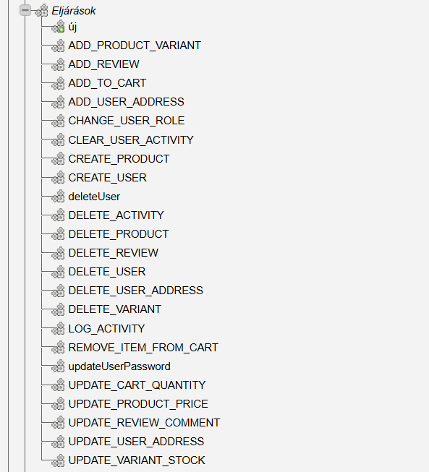
DATABASE – Tóth Erik
Database
I used SQL for managing the database.
It provided structured and reliable data storage.
Allowed efficient handling of products, users, orders, and reviews.
Supported CRUD operations through backend API endpoints.

Slide 22

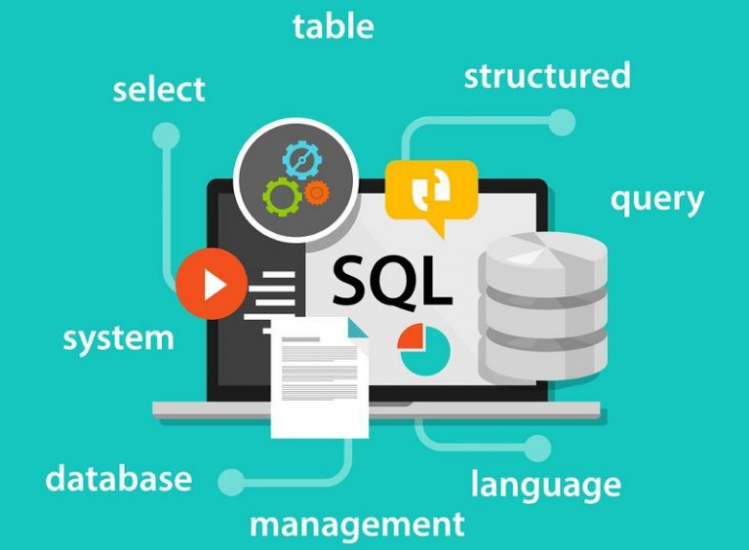
DATABASE – Tóth Erik
Database contents
Main use case: one platform for e-commerce, user profiles, chat, and used-item marketplace
Storage engine: Inno DB
encoding: utf8 / utf8mb4
The database includes 20+ stored procedures for CRUD and business operations
Product catalog: products, kategoria, pictures, product_variants
Commerce flow: cart, orders, order_items, coupons, cart_coupons
User/social
layer: users, profile_meta, profile_messages, profile_ratings, direct_messages, user_activity
Marketplace/community: used_items, used_offers, bands

Slide 23
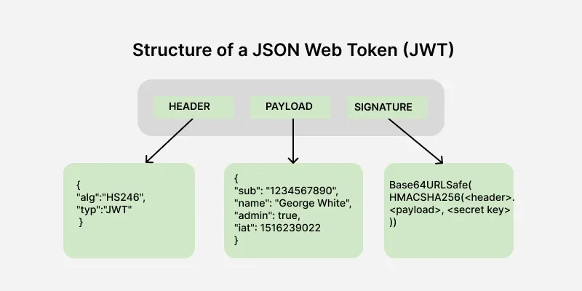

DATABASE – Tóth Erik
Database Security
Passwords are not stored in plaintext; they are hashed with PHP password_hash
Email verification uses random tokens, and only the hash of the token is stored in DB
Authentication is JWT-based with an issued expiration and a 24-hour lifetime
I stored user_id email / username role in JWT tokens

Slide 24

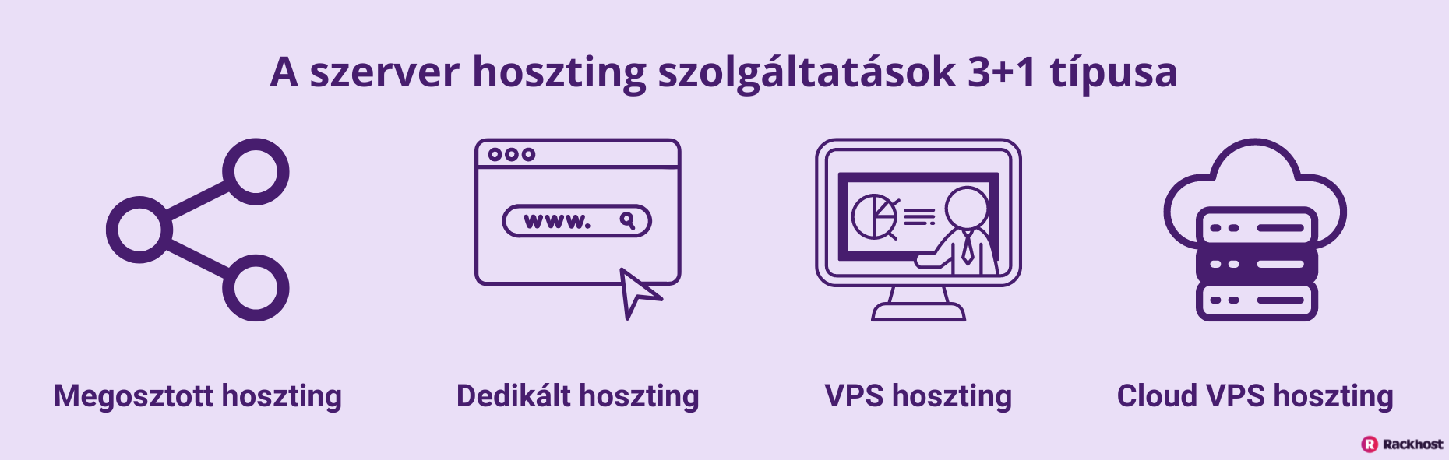

DATABASE – Tóth Erik
VPS/DOMAIN
We used Rackhost to publish and host our website.
I handled the VPS and domain setup, including server configuration.
Database and backend services were connected and tested on the live server.
The infrastructure setup was completed collaboratively with the team.

Slide 25
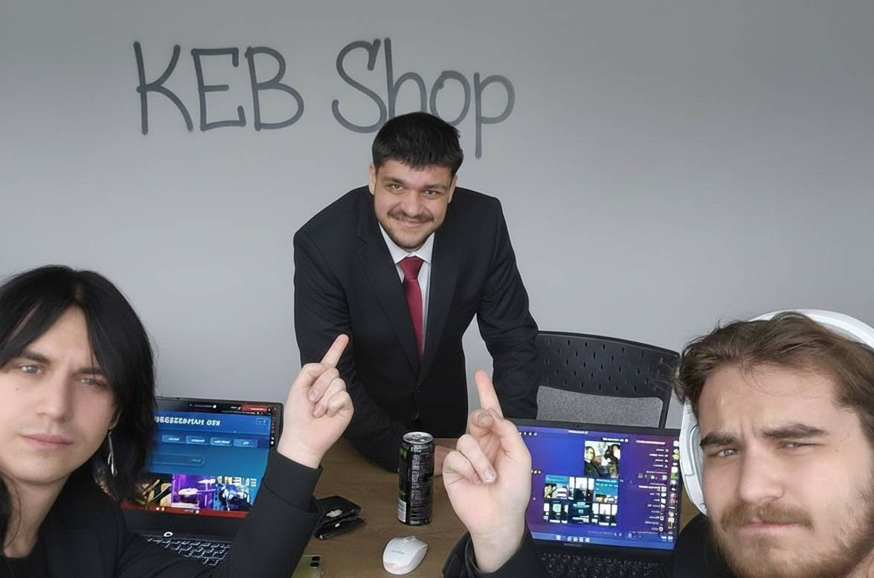
DATABASE – Tóth Erik
Project manager
Coordinated team tasks and workflow
Managed project timeline and milestones
Oversaw feature planning and implementation
Ensured communication between frontend and backend
Supervised testing and deployment phases

Slide 26
Page Demo
DEMO
Add title text
Add title text

Slide 27
Questions
Q&A
Add title text
Add title text

Slide 28
THANK YOU FOR YOUR ATTENTION
Notes:
Add title text

